Slide 1

Cat scratch disease diagnostics
Viktoria Kovacheva MSc Biotechnology

Slide 2
What is CSD?
Bacterial infection caused by Bartonella henselae
It typically occurs after a cat scratch or bite, although it can also be transmitted through contact with cat saliva.
Symptoms often include fever, swollen lymph nodes, and a raised bump or sore at the site of the scratch or bite.
In most cases, cat scratch disease resolves on its own without treatment, but antibiotics may be prescribed for severe cases or complications.

Slide 3
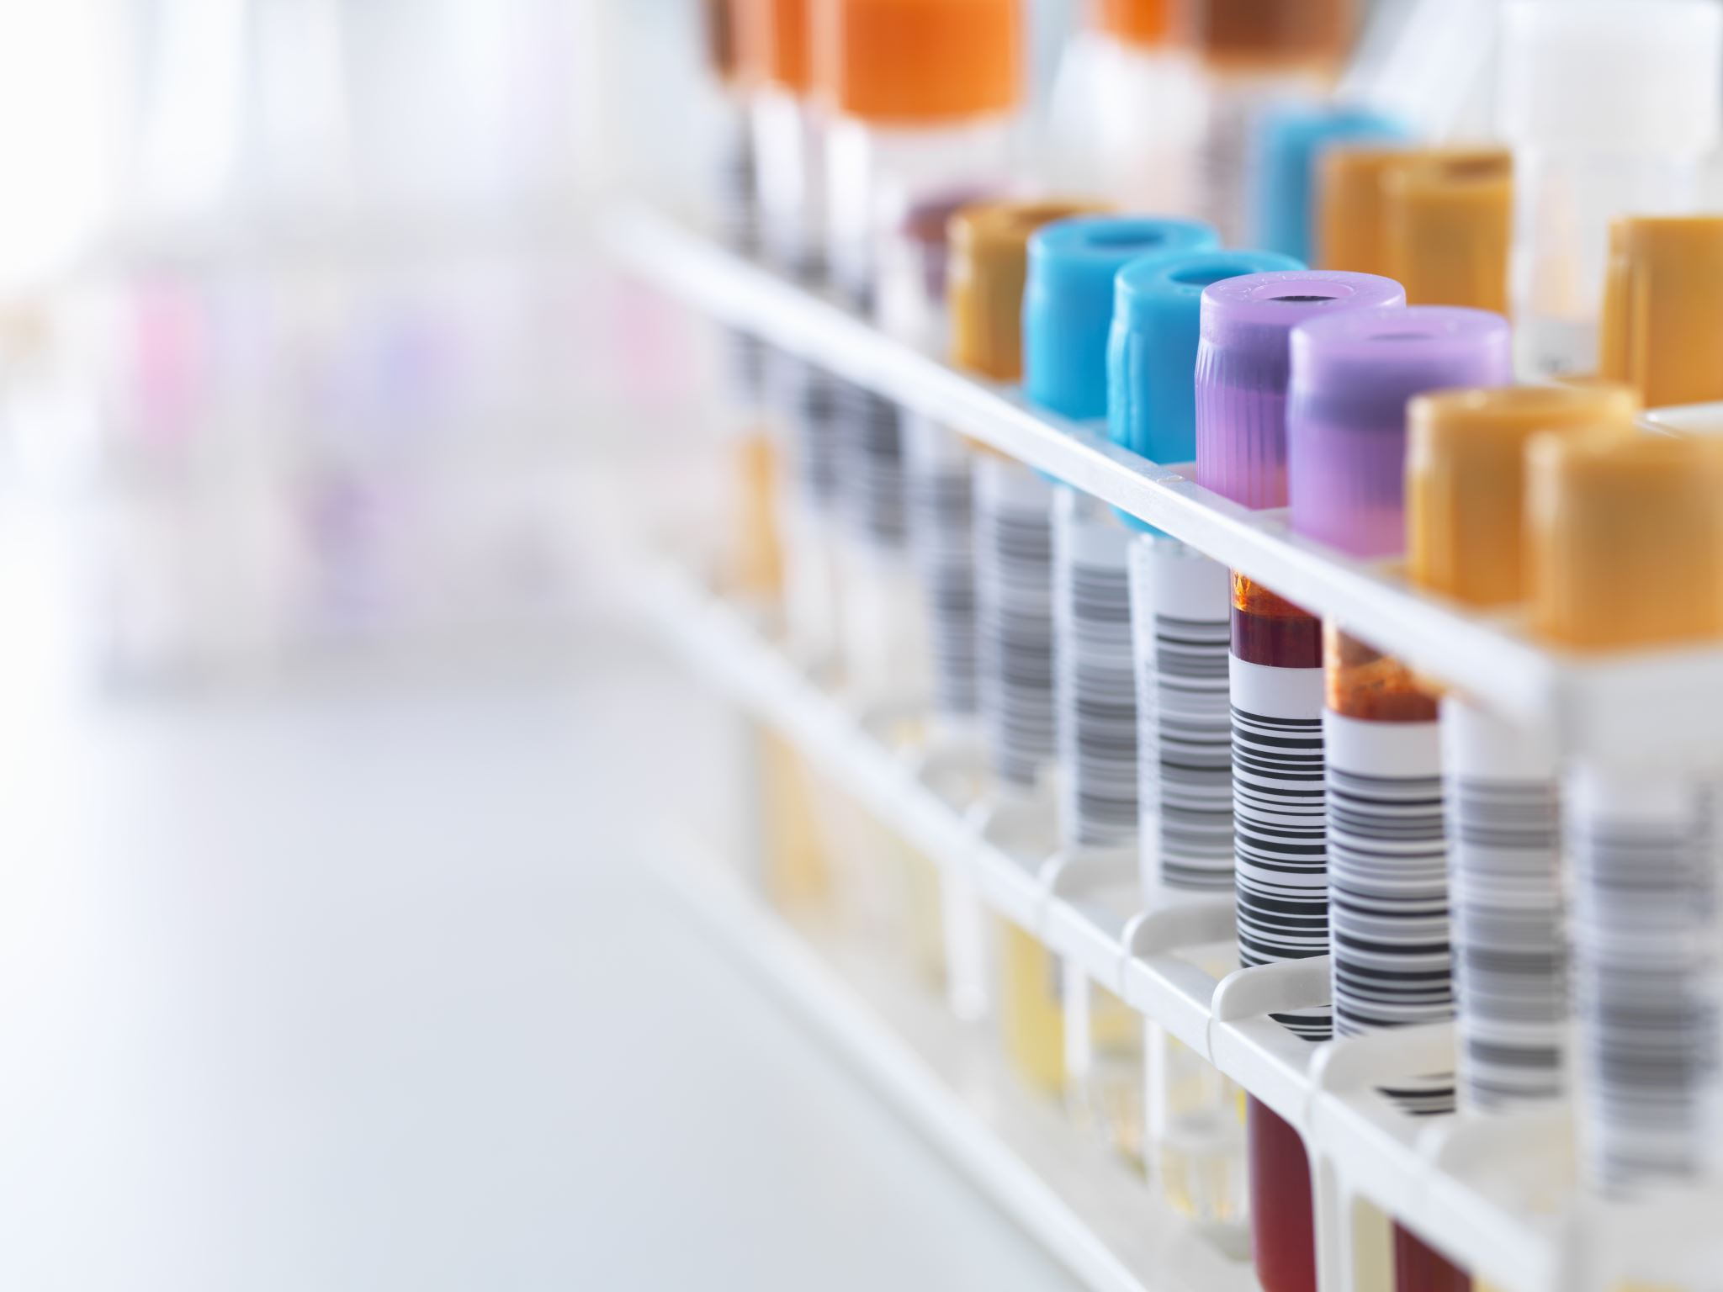
Current CSD diagnostics
Serological test
The analysis includes the detection of antibodies in the blood serum.
Process:
Patient’s serum is diluted to 1:100 and placed on a plate with intact bacteria Bartonella.
Plate is washed using PBS. Antibodies, which recognize Bartonella has remained.
Application of a secondary antibody, which recognizes human antibodies. (easily detectable due FITC, a florescence molecule)

Slide 4

However…
Only some of the bacteria’s surface proteins are immunogenic.
False-positive results (cross-reactivity: different bacteria may present antibodies that will react to some extent only to Bartonella)
Variability of antibody levels (some of the immunogenic antibodies might present in higher or lower concentrations on one day to another)
Long-time for results!
Personal example..

Slide 5

Production of recombinant proteins of immunogenic proteins of Bartonella.
The chosen immunogenic proteins were p26, Ppi, GroEL and AtpD.
Why?
Found in various organisms across different taxa
The general functions of the encoded proteins remain similar
Different people’s immune systems react differently.
A study by Saisongkorh et al., tested various proteins and found that the most frequently recognized ones are p26, Ppi, GroEL and AtpD.

Slide 6
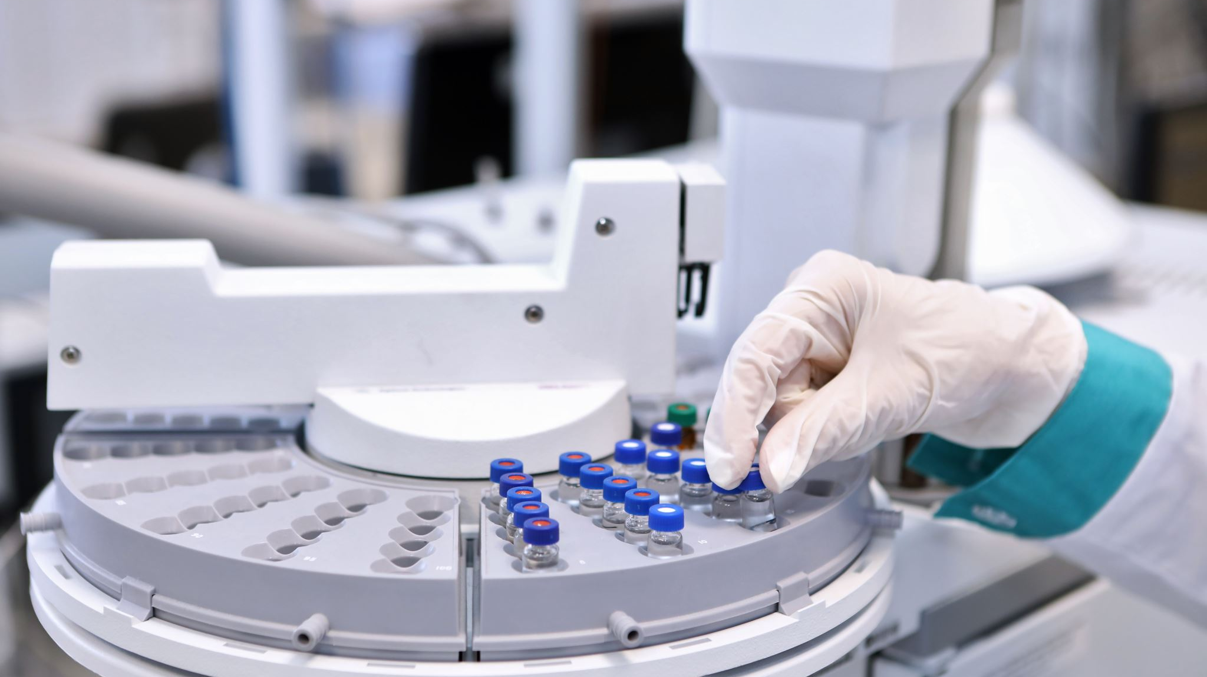
Aim and objectives
Aim: To produce a better diagnostic tool for patients with suspected CSD based on the detection of B. henselae antibodies in patient sera.
Objective 1: Can we make recombinant versions of these immunogenic proteins?
Objective 2: Do the recombinant versions of these proteins retain their immunogenicity?

Slide 7
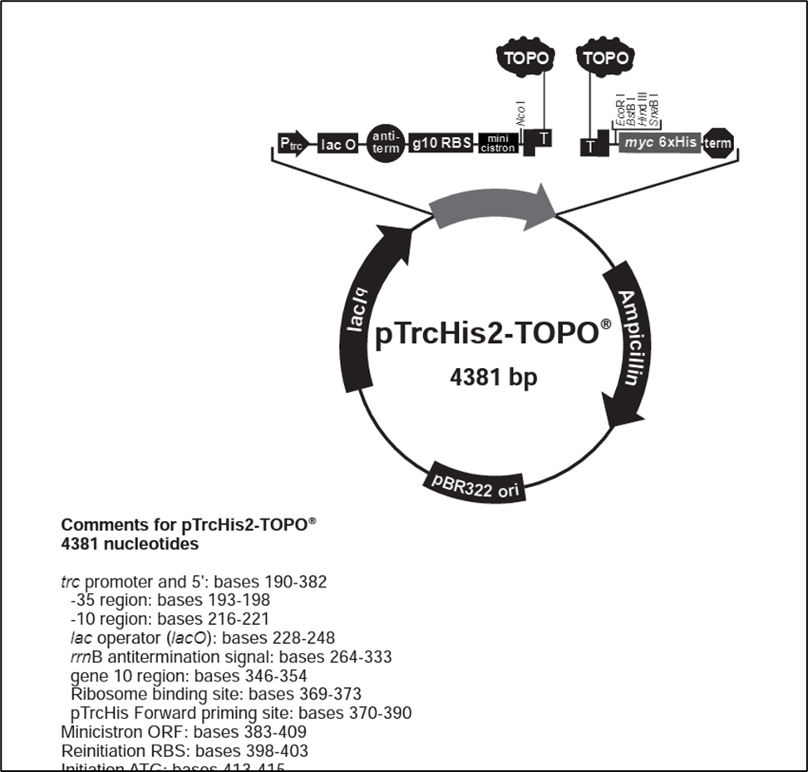
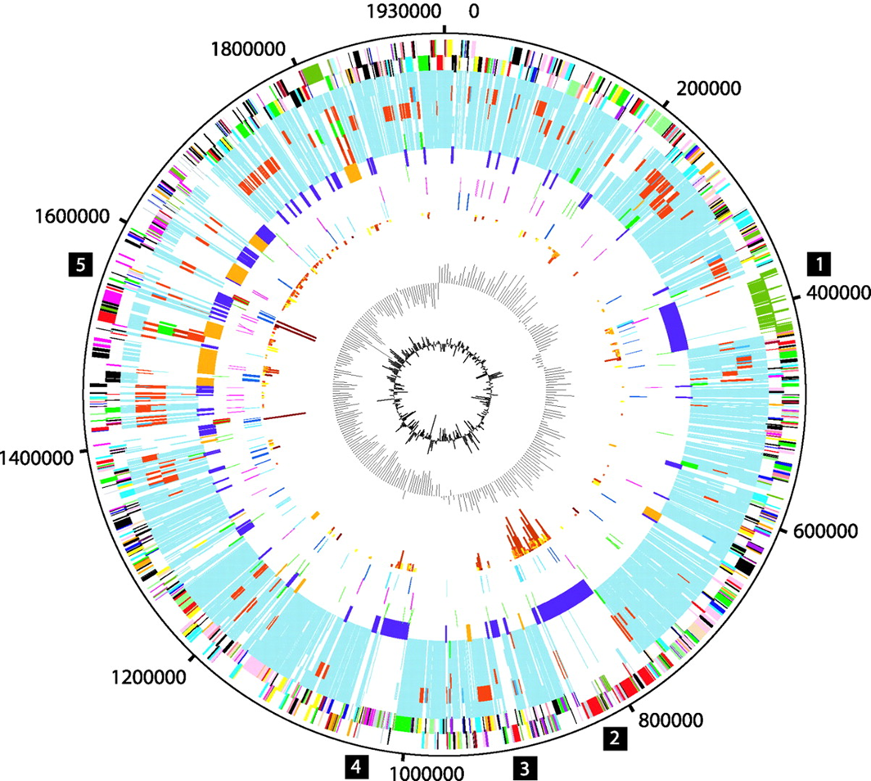
Steps of the study undertaken
1. Identify relevant genes in B. henselae WGS (Artemis).
- Analysed the genome Hiuston 1 as it is the very first strain obtained.
Figure 2. TOPO vector.
2. PCR-amplify ORFs, clone into TOPO vector and transform construct into E. coli. (topoisomerase enzyme; quick, simple to use and effective)
Figure 1. B.henselae genome Hiuston 1.

Slide 8

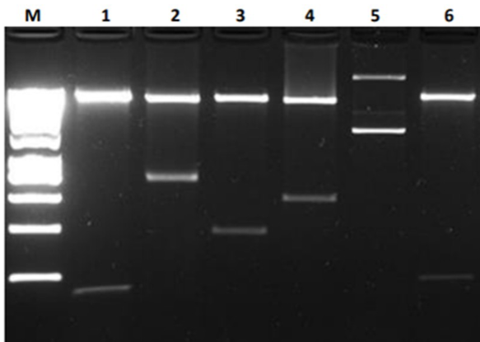
3. Verify presence and orientation of insert in vector.
1 is the right one; as the sequences can go in both directions
The chosen restriction enzymes will cut in a place that will allow us to identify if the gene is inserted in the plasmid.
Figure 3. M, DNA Ladder; 1, p26 forward; 2, p26 reverse; 3, ppi forward; 4, ppi reverse; 5, groEL forward; 6, groEL reverse; 6, undigested plasmid.

Slide 9
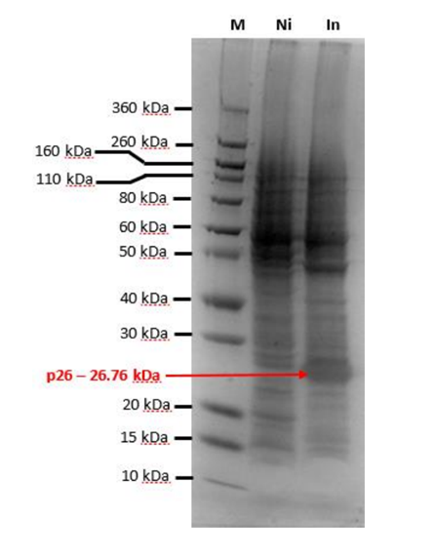
4. Induce expression of recombinant proteins. (SDS-Page)
IPTG induction is regulated by the lacIq operator; transcription starts when operator is switched on.
Figure 4. SDS-PAGE gel on which protein extracts prepared from non-induced (Ni) and induced (In) cultures of E. coli transformed with TOPO plasmid containing the p26 gene. [M is a size ladder]

Slide 10
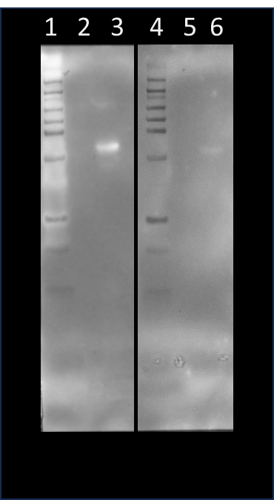


5. Verify existence of recombinant protein and test its immunogenicity. (Western blotting)
30 kDA
25 kDA
Anti-human and anti-mouse antibody and antigens?
Species-specific secondary antibodies ensure the accurate detection of each primary antibody
No cross-reactivity or interference
Precise identification and quantification of the target proteins in the Western blot analysis.
Recombinant p26 protein (26 kDA)
anti-HIS
anti-B. henselae
Figure 5. Western blots; The left-hand blot was probed with anti-HIS antibodies and the right-hand blot with anti-Bartonella henselae antibodies (serum from a CSD patient). Lanes 1 and 4, Ladder; Lanes 2 and 5, contain blotted proteins from E. coli that contain the plasmid construct but without inducing expression of the recombinant P26 in the construct; Lanes 3 and 6; contain blotted proteins from E. coli that contain the plasmid construct and which have been induced to express the recombinant P26.

Slide 11
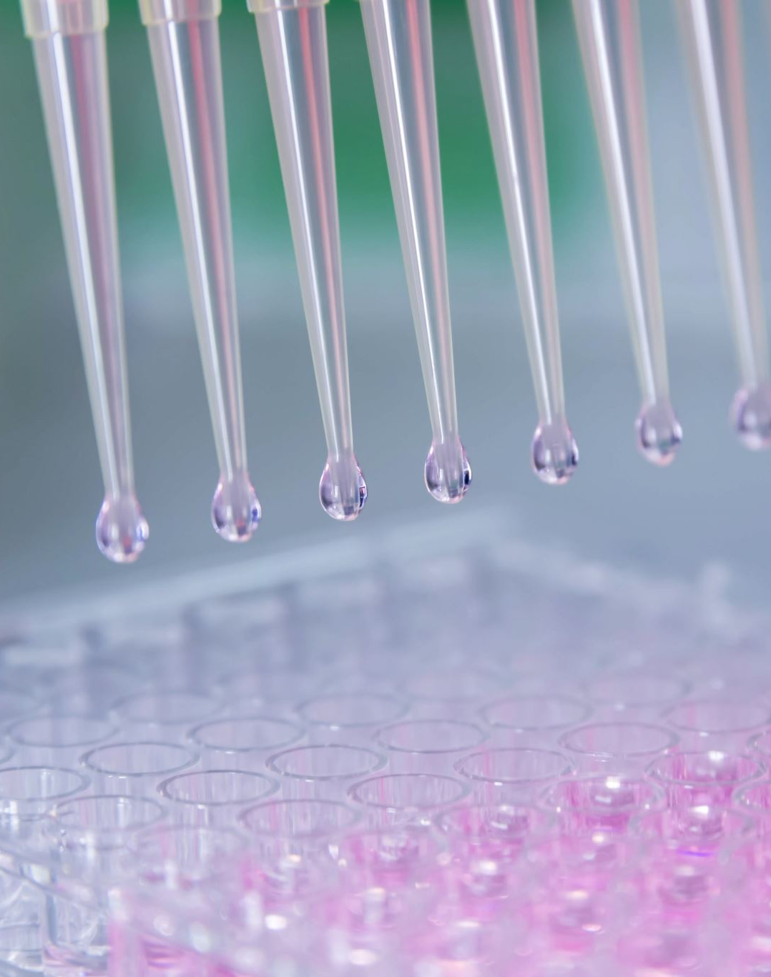
Study conclusion
We can create a recombinant protein of p26 protein, which will keep its immunogenicity.
Has the potential to serve as antigen in a novel serodiagnostic assay for CSD.
However:
The recombinant protein reacted with a serum from one patient with CSD only…
Patient’s immune systems react differently.. (Saisongkorh et al.)
Therefore, far away from commercializing this test…

Slide 12
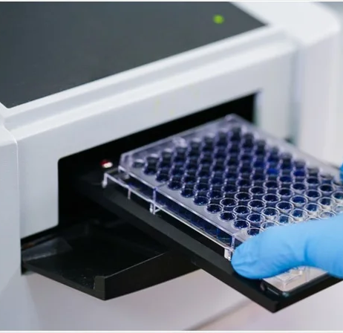
ELISA : High-throughput seroepidemiological analysis
Evaluation of the performance of recombinant protein p26 for CSD diagnosis
Assay must be: useful, easy, quick and cheap!
Objective: Create rp26-based ELISA and use multiple patient’s sera for routine anti-B. henselae IFA testing and for evaluation of the rp26-based ELISA.

Slide 13
1. Purification: Purification of rp26 protein by affinity chromatography.
2. Coating: Dillution of purified rp26 with coating buffer (e.g.Bicarbonate b., pH 9.6) and loading to 96-well plates.
3. First incubation: Incubation of coated plates overnight at 4 degrees C.
4. Washing: After the incubation, washing of wells 5 times to remove any unbound or non-specifically bound molecules from the surface. (e.g. 0.05% TWEEN in PBS)
5. Blocking: The wells are treated with a blocking agent bovine serum albumin (BSA) in PBS to prevent non-specific binding of other molecules to the surface.
6. Second incubation: Incubation of coated plates for 60 min at 37 degrees C.
7. Repeat steps 4,5,6.
8. Detection: Addition of diluted conjugated antibody. (e.g. anti-human IgG)
9. Repeat step 6.
10. Substrate Addition: Substrate addition (e.g. TMB Peroxidase EIA Substrate) producing a detectable signal.
11. Signal Measurement: The results are read by spectrophometer, at optical density of 450 nanometers.

Slide 14

Indirect Immunofluorescence Assay (IFA): Serum samples diluted and screened for specific fluorescence signals indicating the presence of anti-B. henselae IgG antibodies.
3 Sample Categories:
Samples from patients with PCR-confirmed Bartonella infections.
Samples from patients with clinically suspected B. henselae infections and positive IFA results.
Samples from IFA-positive blood donors.
Control Samples: Negative control serum samples from healthy blood donors. (if the IFA titer is <1:80)
PCR-Based Detection of Bartonella DNA: Nested PCR targeting the Bartonella 16S rRNA genes and a PCR targeting the 16S-23S rRNA intergenic transcribed spacer (ITS) region will be performed to detect Bartonella DNA.
Sequencing and Analysis: 16S rRNA gene and ITS-PCR products will be sequenced and compared to sequences in the GenBank database to determine the species of Bartonella present in the samples.

Slide 15


Advantages → ELISA alone cannot directly detect the pathogen itself or other components, such as nucleic acids or toxins. However, combined with the high-throughput sequencing of the samples, detection of non-antibody target is possible. → In view of the rising incidence of CSD, the recombinant outer membrane protein-based ELISA will be helpful for screening a large sample size of human sera for serosurveillance study. → High sensitivity → Cost-effective → High-throughput → Customization

Slide 16


Limitations
ELISA can sometimes produce false-positive results due to cross-reactivity with antibodies generated against related pathogens or non-specific binding of antibodies to similar antigens.
Increased complexity which can arise from the need to coordinate multiple steps, instruments, and data analysis pipelines, which may require additional expertise and resources. (However reduced if automated)
The integration of both ELISA and sequencing methods can demand considerable resources, such as specialized equipment, specific reagents, skilled personnel, and computational tools for data analysis.

Slide 17
References
Biancardi, A. L., & Curi, A. L. L. (2014). Cat-scratch disease. Ocular immunology and inflammation, 22(2), 148-154.
Boonaramrueng, K. (2021). Development of Elisa for detecting antibody against Bartonella spp. specific protein in cats and its application in natural infection.
Hosseini, S., Vázquez-Villegas, P., Rito-Palomares, M., Martinez-Chapa, S. O., Hosseini, S., Vázquez-Villegas, P., ... & Martinez-Chapa, S. O. (2018). Advantages, disadvantages and modifications of conventional ELISA. Enzyme-Linked Immunosorbent Assay (ELISA) from A to Z, 67-115.
Hu, T., Chitnis, N., Monos, D., & Dinh, A. (2021). Next-generation sequencing technologies: An overview. Human Immunology, 82(11), 801-811.
Jost, M., Latz, A., Ballhorn, W., & Kempf, V. A. (2018). Development of a specific and sensitive enzyme-linked immunosorbent assay as an in vitro diagnostic tool for detection of Bartonella henselae antibodies in human serum. Journal of Clinical Microbiology, 56(12), 10-1128.
Koutantou, M., Kambas, K., Makka, S., Fournier, P. E., Raoult, D., & Angelakis, E. (2023). Limitations of serological diagnosis of Typical cat scratch disease and recommendations for the diagnostic Procedure. Canadian Journal of Infectious Diseases and Medical Microbiology, 2023.
Maurin, M., Eb, F., Etienne, J., & Raoult, D. (1997). Serological cross-reactions between Bartonella and Chlamydia species: implications for diagnosis. Journal of clinical microbiology, 35(9), 2283-2287.
Saisongkorh, W., Kowalczewska, M., Azza, S., Decloquement, P., Rolain, J. M., & Raoult, D. (2010). Identification of candidate proteins for the diagnosis of Bartonella henselae infections using an immunoproteomic approach. FEMS microbiology letters, 310(2), 158-167.
Souza, I. I., Melo, E. S., Ramos, C. A., Farias, T. A., Osório, A. L. A., Jorge, K. S., ... & Araújo, F. R. (2012). Screening of recombinant proteins as antigens in indirect ELISA for diagnosis of bovine tuberculosis. Springerplus, 1, 1-6.
Zhu, Y., Xu, M., Ding, C., Peng, Z., Wang, W., Sun, B., ... & Hu, Z. (2022). Metagenomic next-generation sequencing vs. traditional microbiological tests for diagnosing varicella-zoster virus central nervous system infection. Frontiers in Public Health, 9, 738412.

